Slide 1

Login and Register form using Using Netbeans & mysql
A Presentation on
Presented by: Mahesh Gadhe

Slide 2




INTRODUCTION
To develop an login and register form using netbeans and mysql with the username and password.
After filling the proper details of user we can can register with username ,password ,address etc and register ourself.
This system helps users to register themselves and login and open dashboard.

Slide 3
OBJECTIVE OF THE PROJECT:-
This project is very useful for users to register themselves and entering the loggin button dashboard opens with welcome message.
This project uses good technology i.e java and mysql.

Slide 4
STRUCTURE OF PROJECT:-
Login.java panel: It contains username and password field also contains login button and register button. When user write username and password and hit login button dashboard opens with welcome message.
Register panel:It contains username firstname,middlename,lastname,address etc fields related to users and back to login button and register button.
Dashboard panel: When hitting login button dashboard panel opens with welcome message.

Slide 5
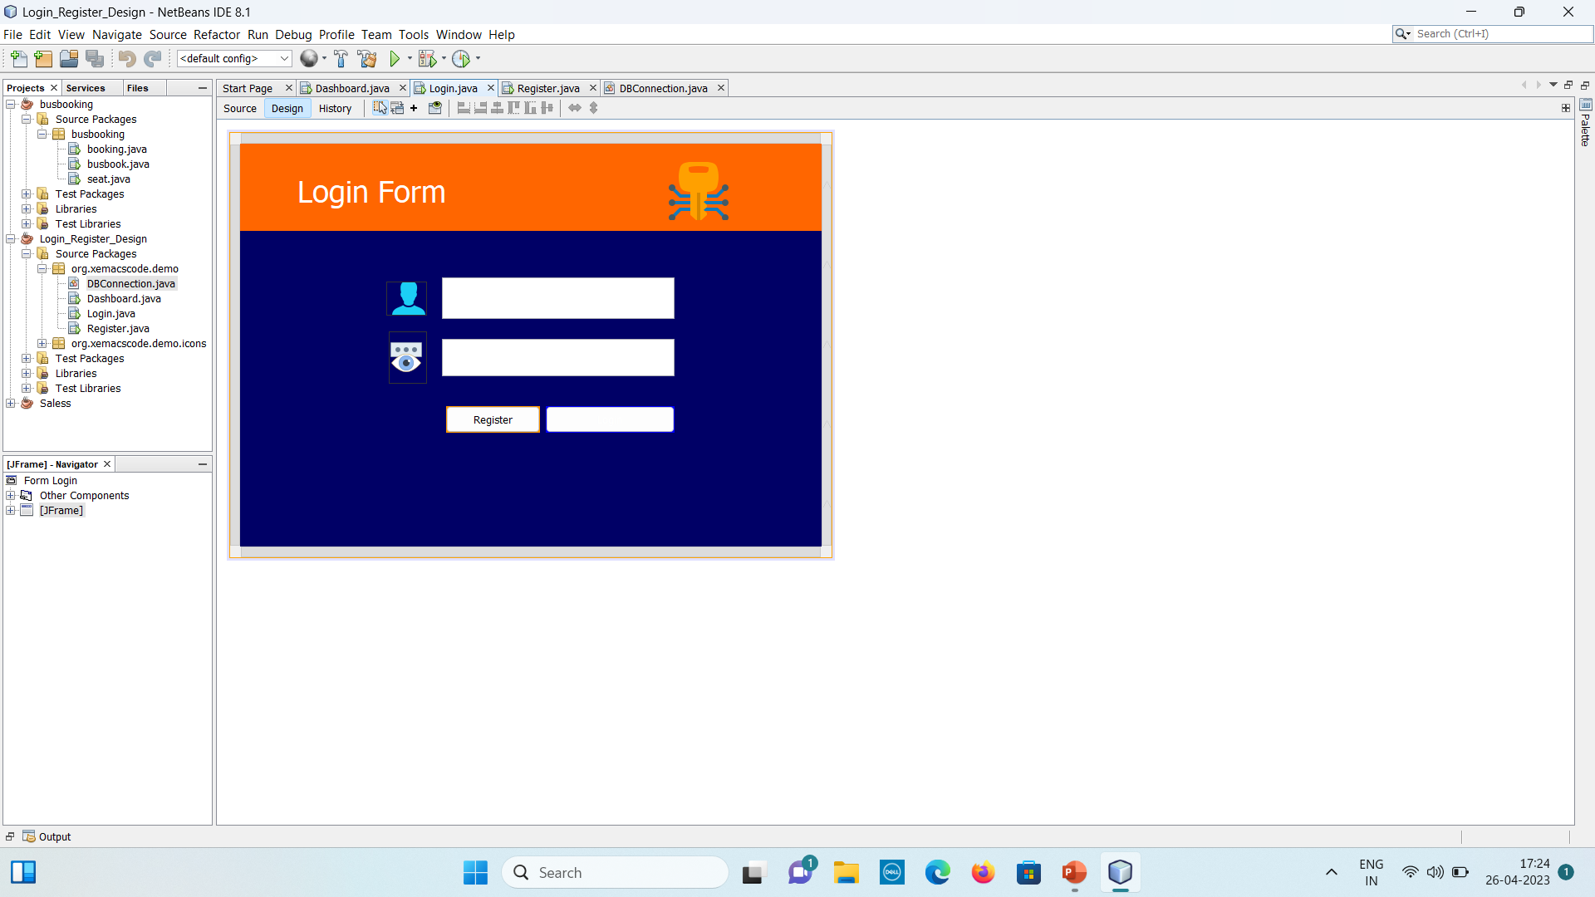
Outcome

Slide 6
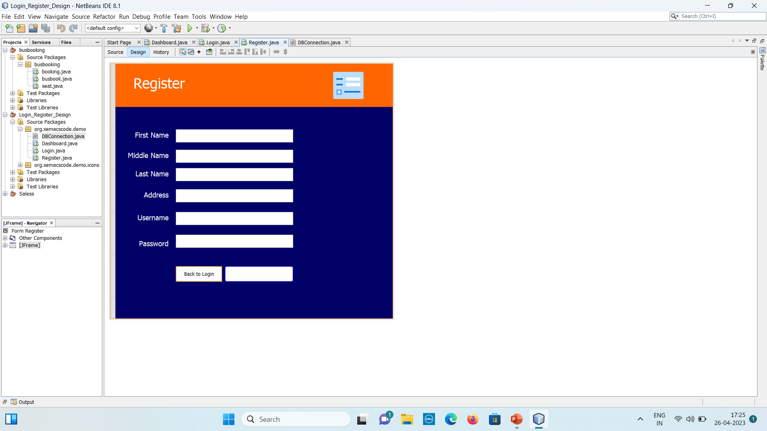

Slide 7
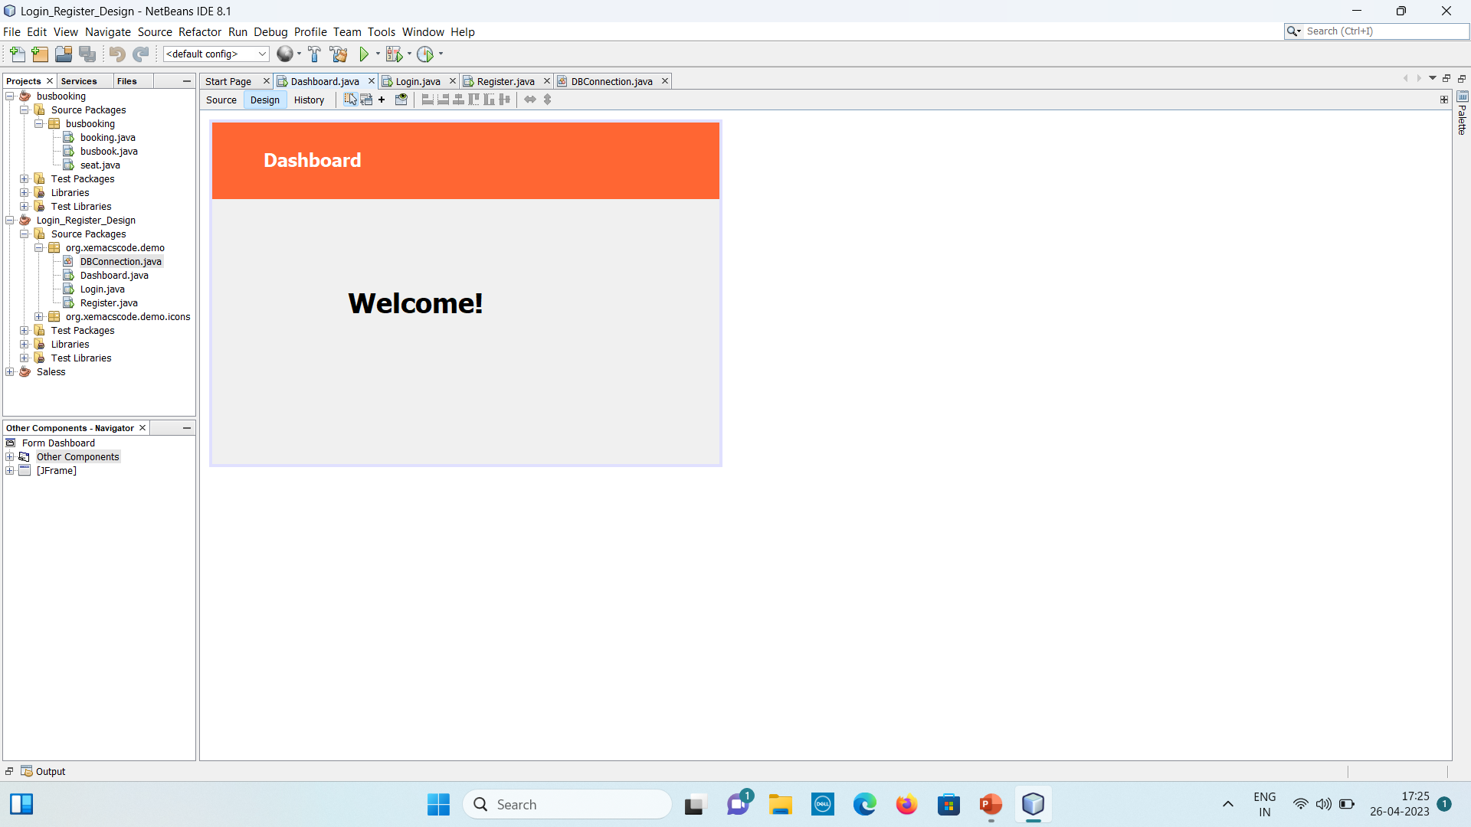

Slide 8
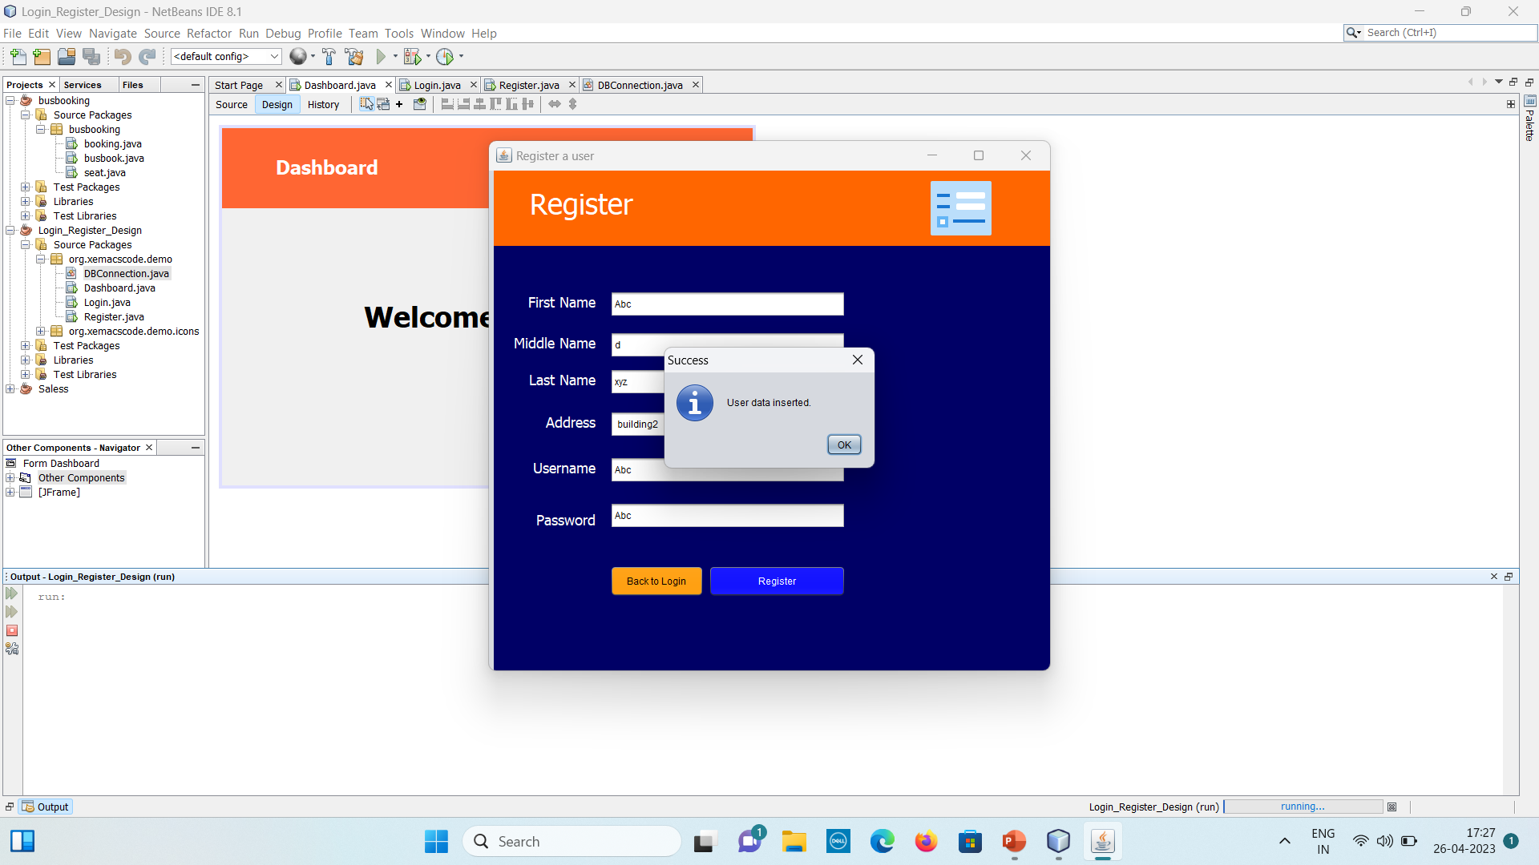

Slide 9
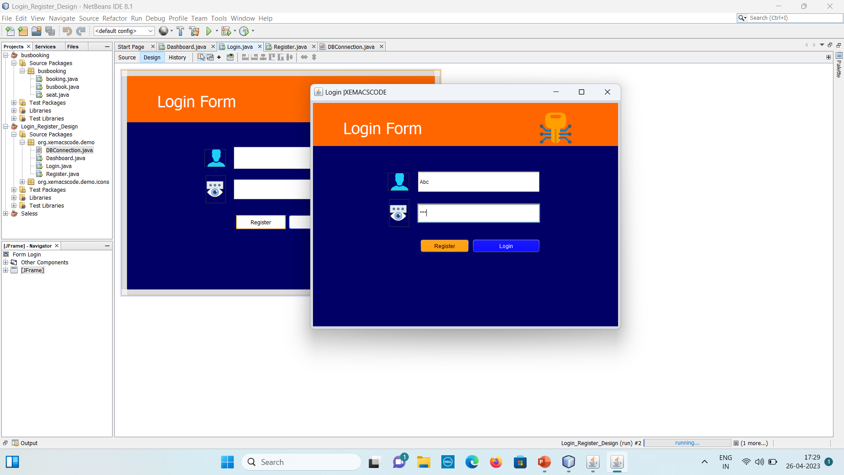

Slide 10

ADVANTAGES OF PROJECT:-
Help in maintain the login credential of users.
Easy to use.
Flexible
Increase the efficiency.
Reduce the time

Slide 11

REQUIREMENTS OF PROJECT:-
Window 10/XP
Installed java editor
Installed java jre
Installed java jdk
Installed Net Beans
Installed Mysql workbench

Slide 12
Future Scope
Helps our friends ,family in future.
As any human don’t have much time so it helps customer to save time.

Slide 13


